Slide 1

Movie Theater Chain Ticketing and Social Media Platform
Team 2b
Jack Bentsen
PO Yu Chao
Chia Yu Hsu
Zhou Jin
Instructor: Mike McKee

Slide 2

Outline
Introduction
Purpose
Entity Relationship Diagram
Database Implementation
GUI Application Instructions
DEMO - Query Runner / Console Application
Future Improvements
Q&A

Slide 3
Introduction
The scenario of this project is to record the popular movies with customers rating in the past 10 years. Our project break out for three parts.
Firstly, we collect the recent ten years popular movies data with relative directors.
Secondly, we retrieve the theatre information, movie showing time and box office performance with the relative movies.
Lastly, through this platform, users can easily track the ratings with the movies and their friend’s favors of movies.

Slide 4
Purpose
Our database collects data of recent 10 years popular movies.
Client can get details of sales performance of movie theatres.
Through out rating information, user can easily find the movie with good reputation.
Movie enterprise can use this database to do business analysis and marketing strategies.

Slide 5
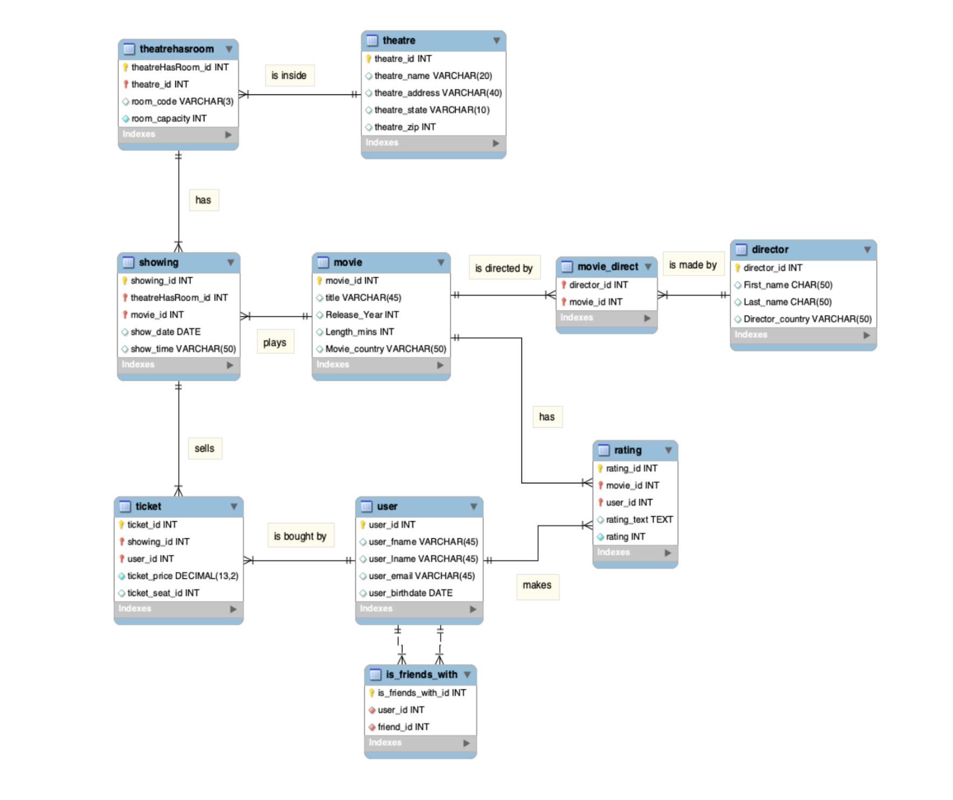
ERD Entity–relationship model

Slide 6

Database Implementation

Slide 7
Query 1:
This query helps user to find out the movie(s) directed by Joss Whedon.
Output:
Query 2:
This query helps user to find all the movies with more than one director.
Output:

Slide 8
Query 3:
This query helps user to find out the top three longest movies in terms of time.
Output:
Query 4:
This query displays the movies that were played in the VIP rooms in theatre during year 2019..
Output:

Slide 9
Query 5:
This query displays movies whose showing dates are between 2019/11/15 and 2019/11/21. Also, it displays in which theatre the movies are shown.
Output:
Query 6:
This query shows the number of tickets sold and the total values of each showing sorted by the order of the descending total sales amount and showing id.
Output:

Slide 10
Query 7:
This query shows the available seats for each movie showing.
Output:
Output:
Query 8:
This query shows the highest rated movies from everyone.

Slide 11
Query 9:
This query shows movies with the largest number of ratings.
Output:
Query 10:
This query shows the total sales for each movie showing and is grouped together by its movie id, showing date and showing time.
Output:

Slide 12
Query 11:
This query finds out the director for the Avengers movie series and shows the average ratings for each one in the series
Output:

Slide 13
Stored Procedure 1:
This stored procedure helps user to find all his/ her friends in the database. Users will be able to quickly find his/ her friends list by calling this stored procedure.
Example call:
Output from example call:

Slide 14
Stored procedure 2:
This stored procedure gets all the ratings from the given user. User can use this stored procedure to get all his/her ratings on movies as a sorted table.
Example call:
Output from example call:

Slide 15
Stored procedure 3:
This stored procedure gets the highest average rating on movies they have rated, and this would help friends to make recommendations easier by checking their highest ratings on movies.
Example call:
Output from example call:

Slide 16

GUI Application Instructions

Slide 17
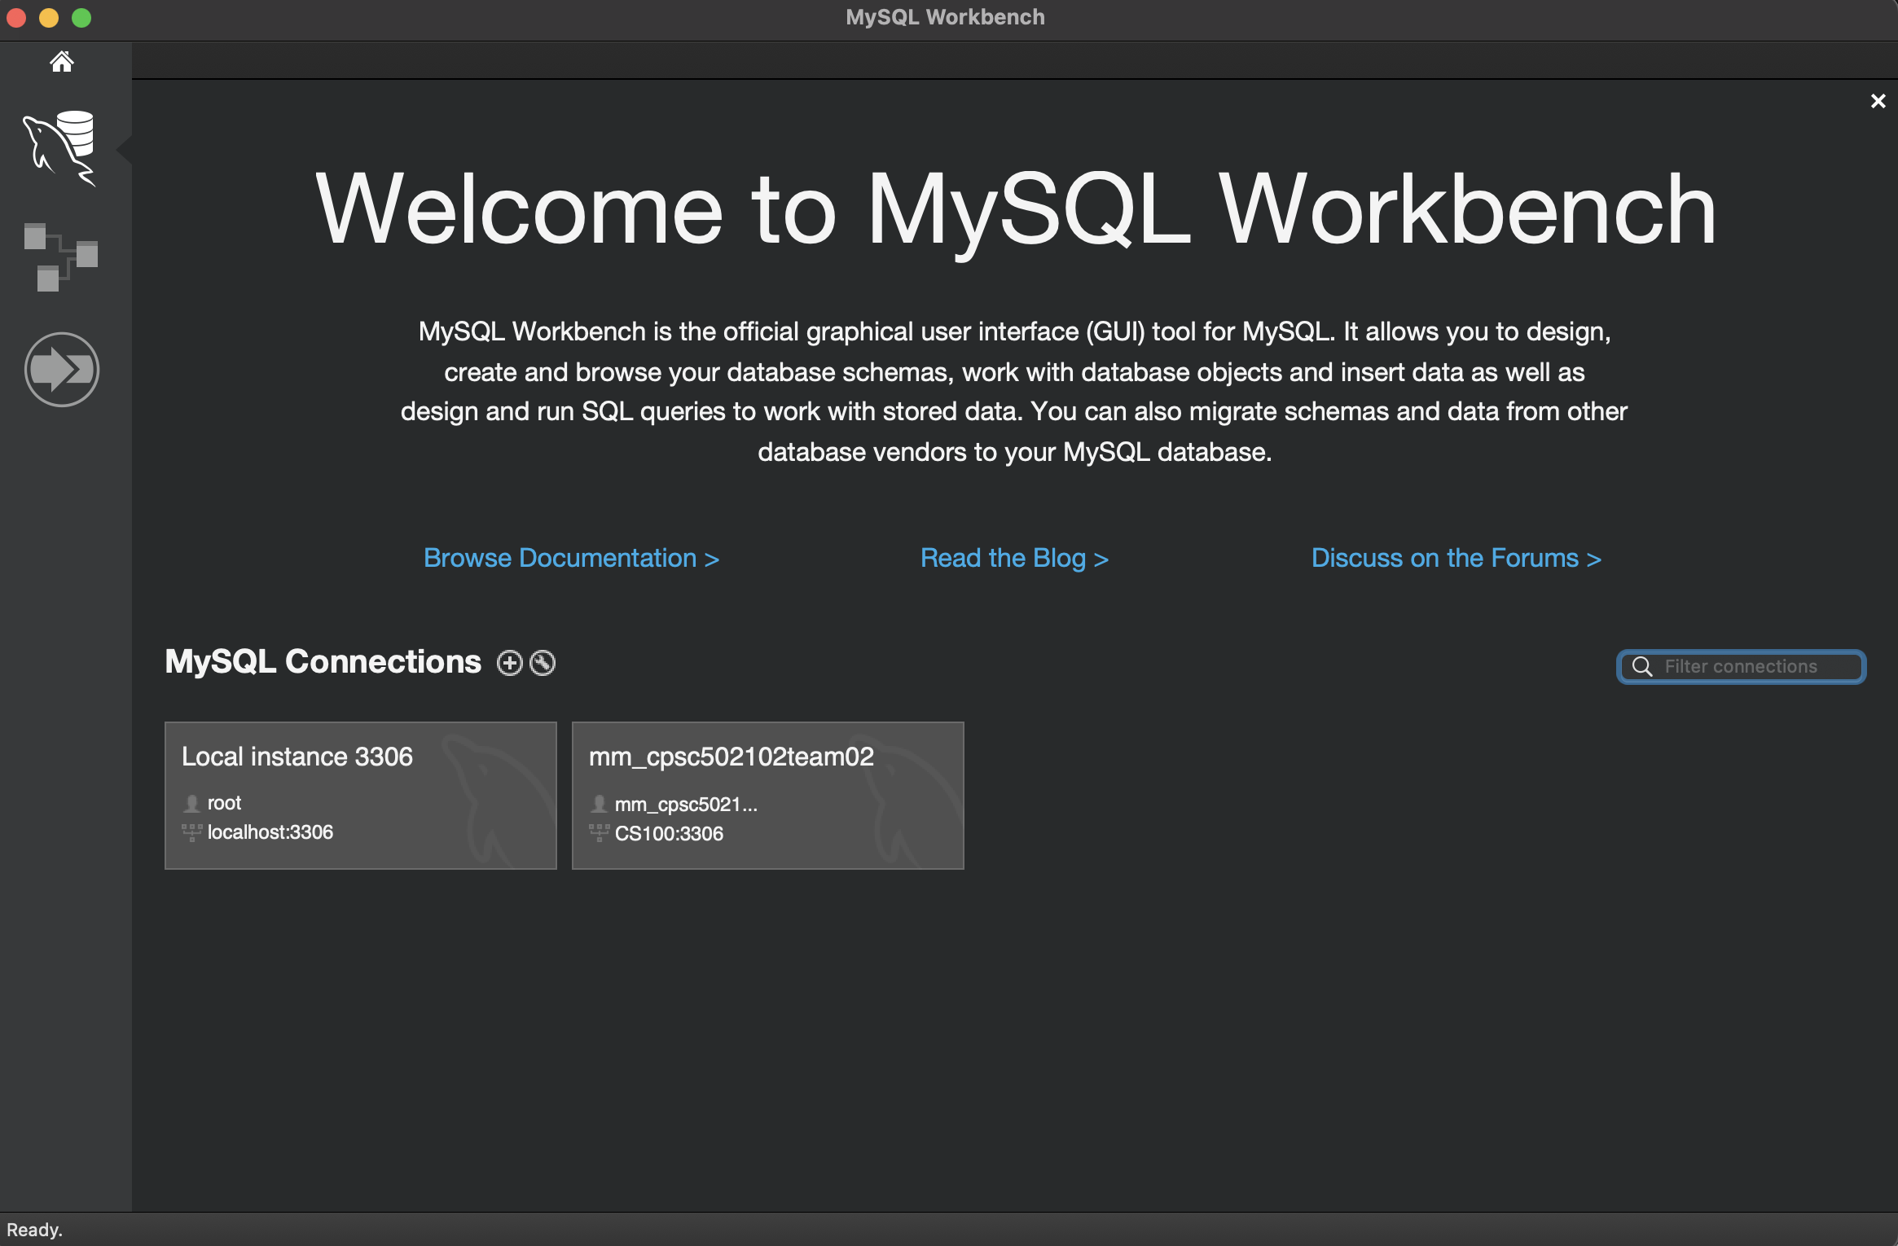
Step 1: create database
Open MILESTONE2DUMP.sql in MYSQL
Use Local instance 3306

Slide 18
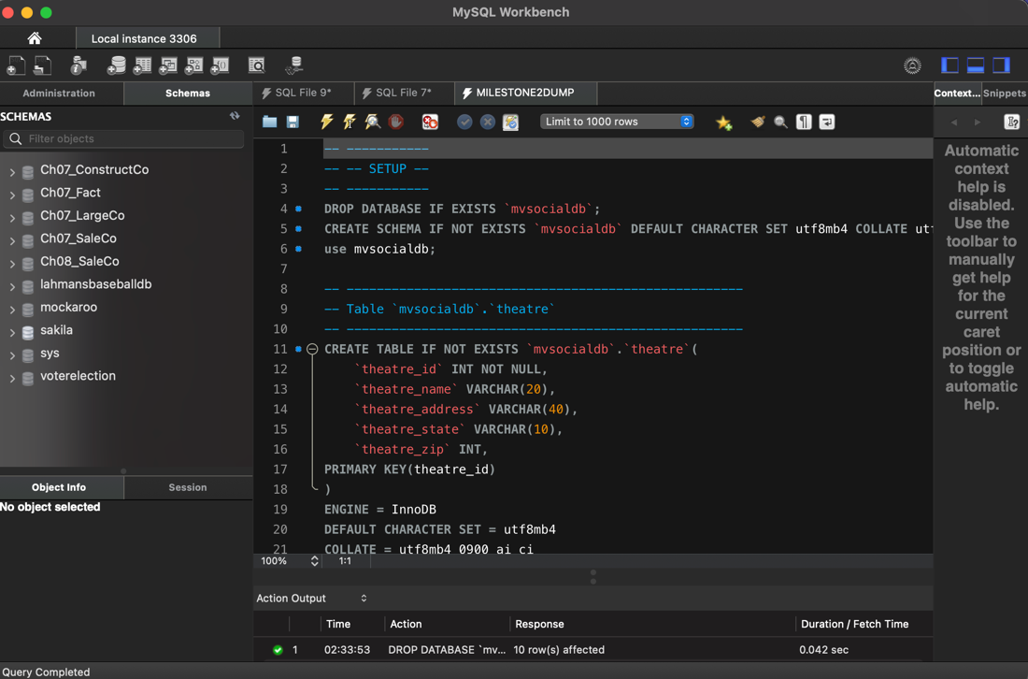
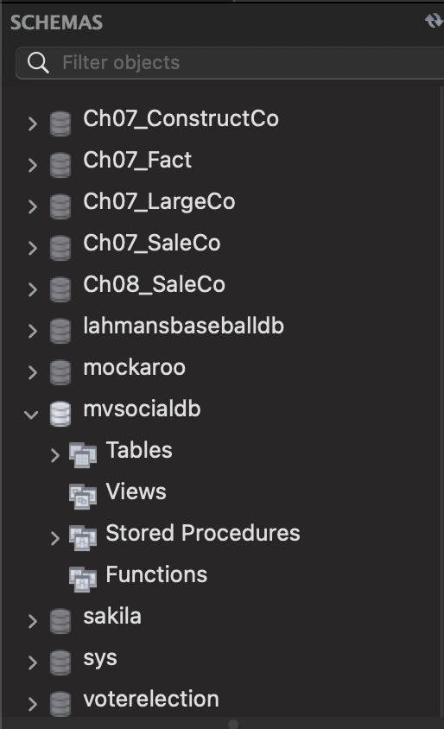

Slide 19
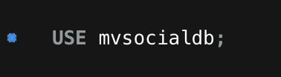
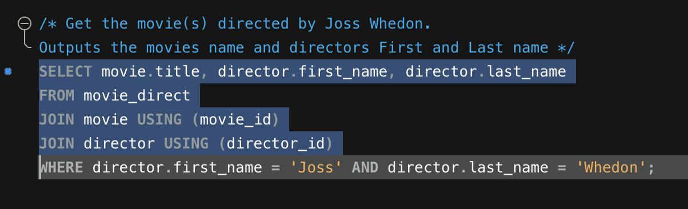
Step 2: test queries

Slide 20
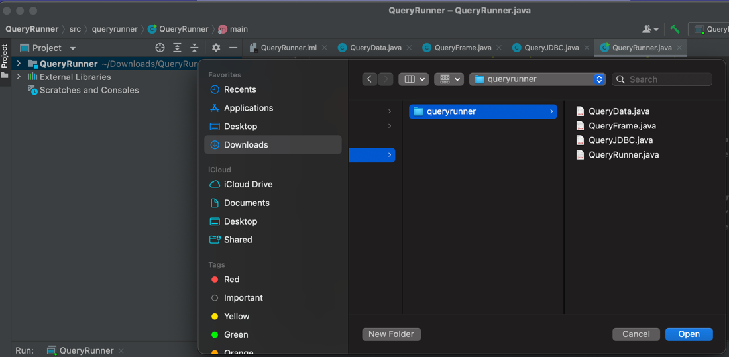
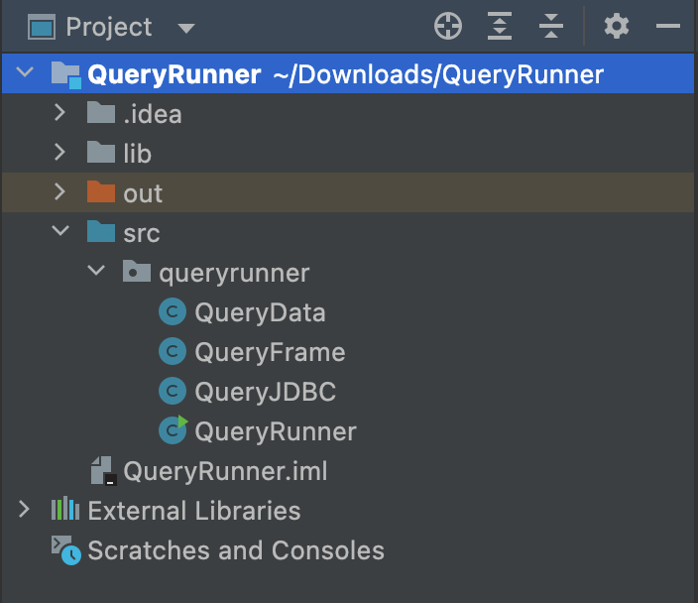

Step 3: Java – QueryRunner (Option 1)
Open the QueryRunner zip file with IntelliJ

Slide 21
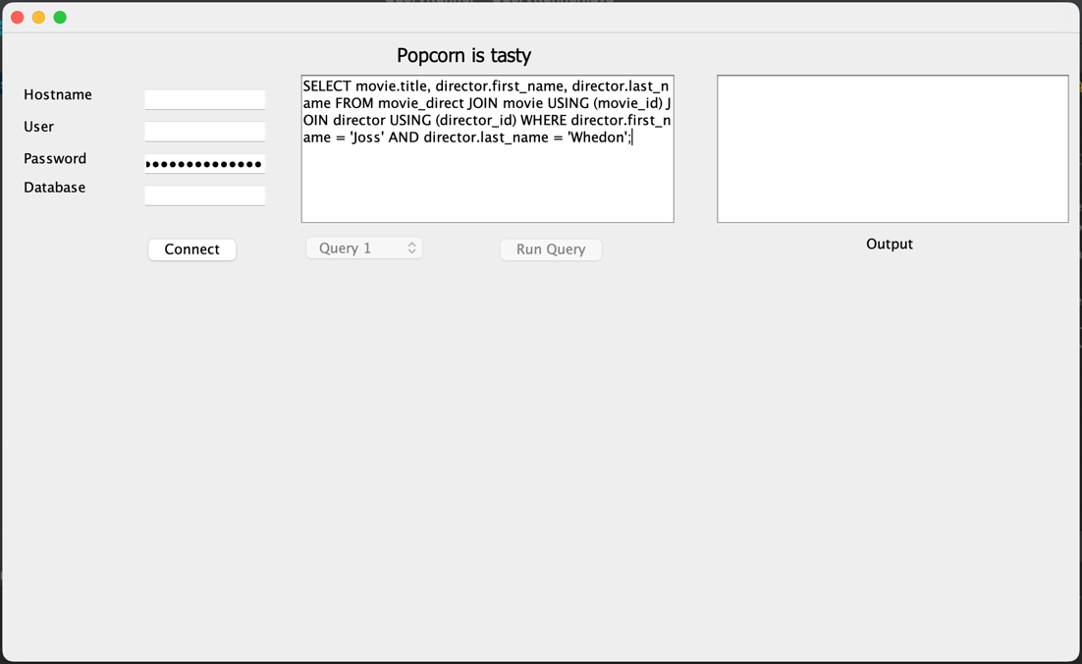
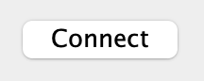
Use information:
Hostname: localhost
User: root
Password: root password set for MYSQL
Database: mvsocialdb

Slide 22
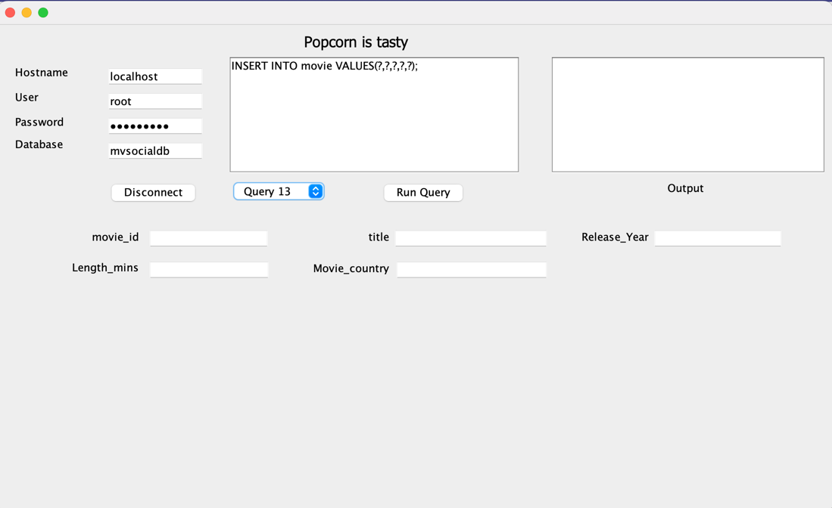
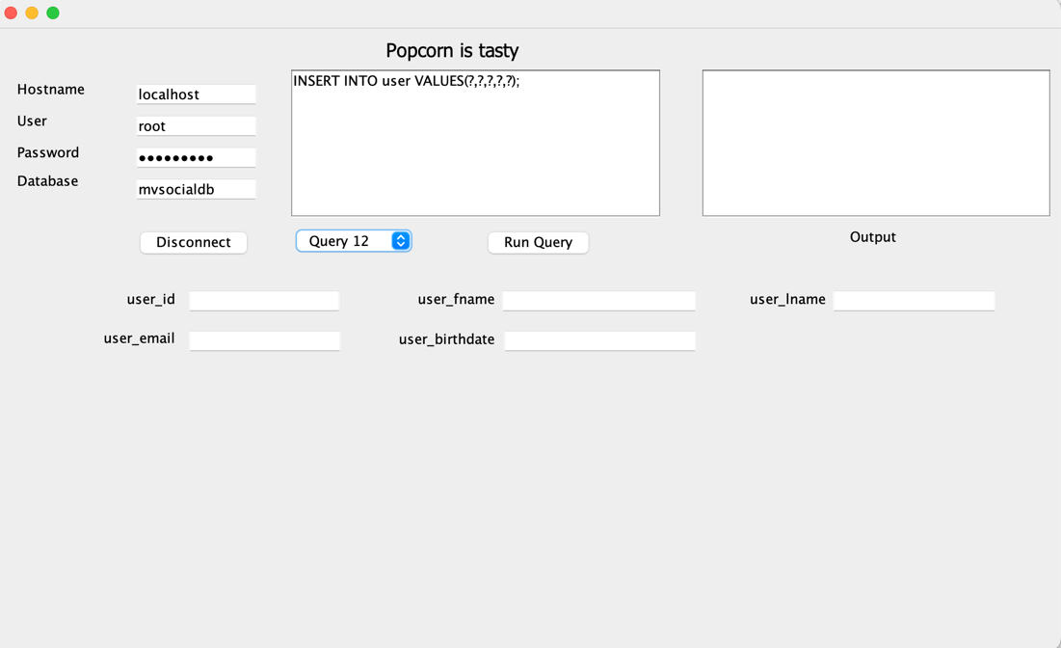
For queries with parameters

Slide 23
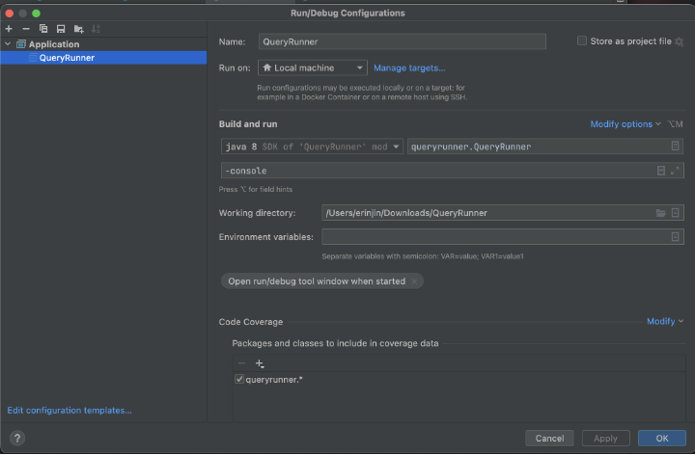
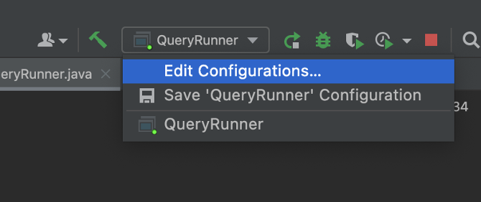
Option 2: run in console (no pop-up window)

Slide 24
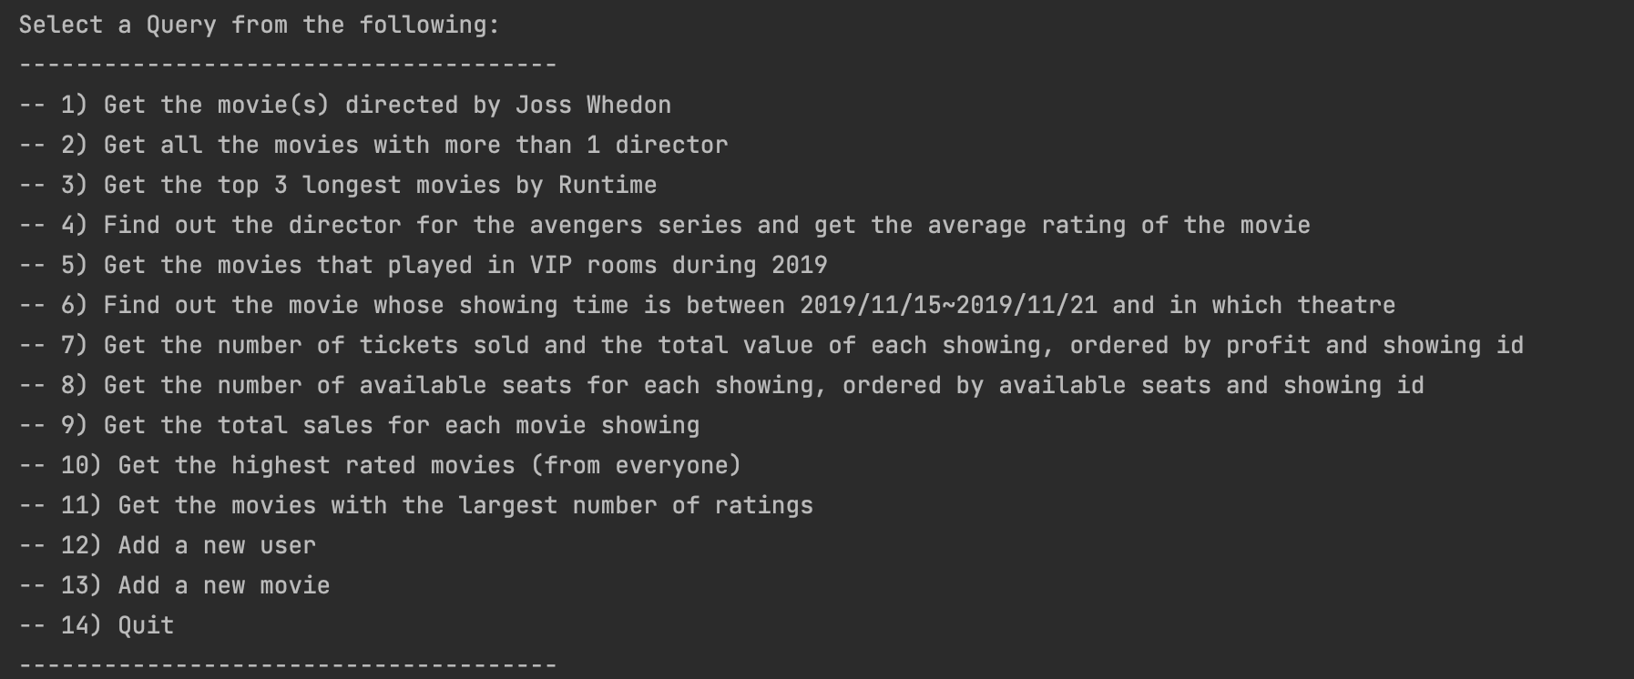
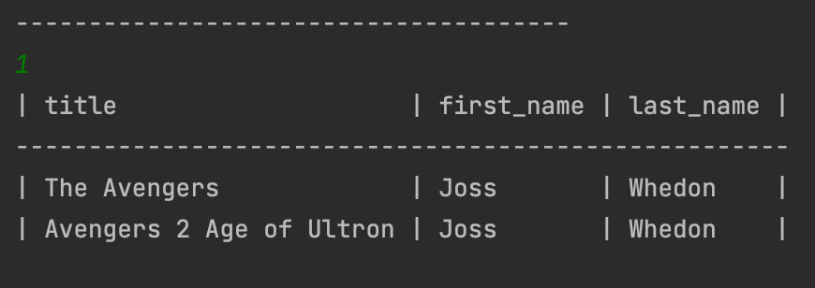
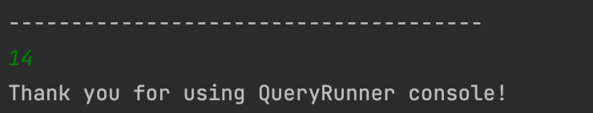

Slide 25

DEMO - Query Runner / Console Application

Slide 26
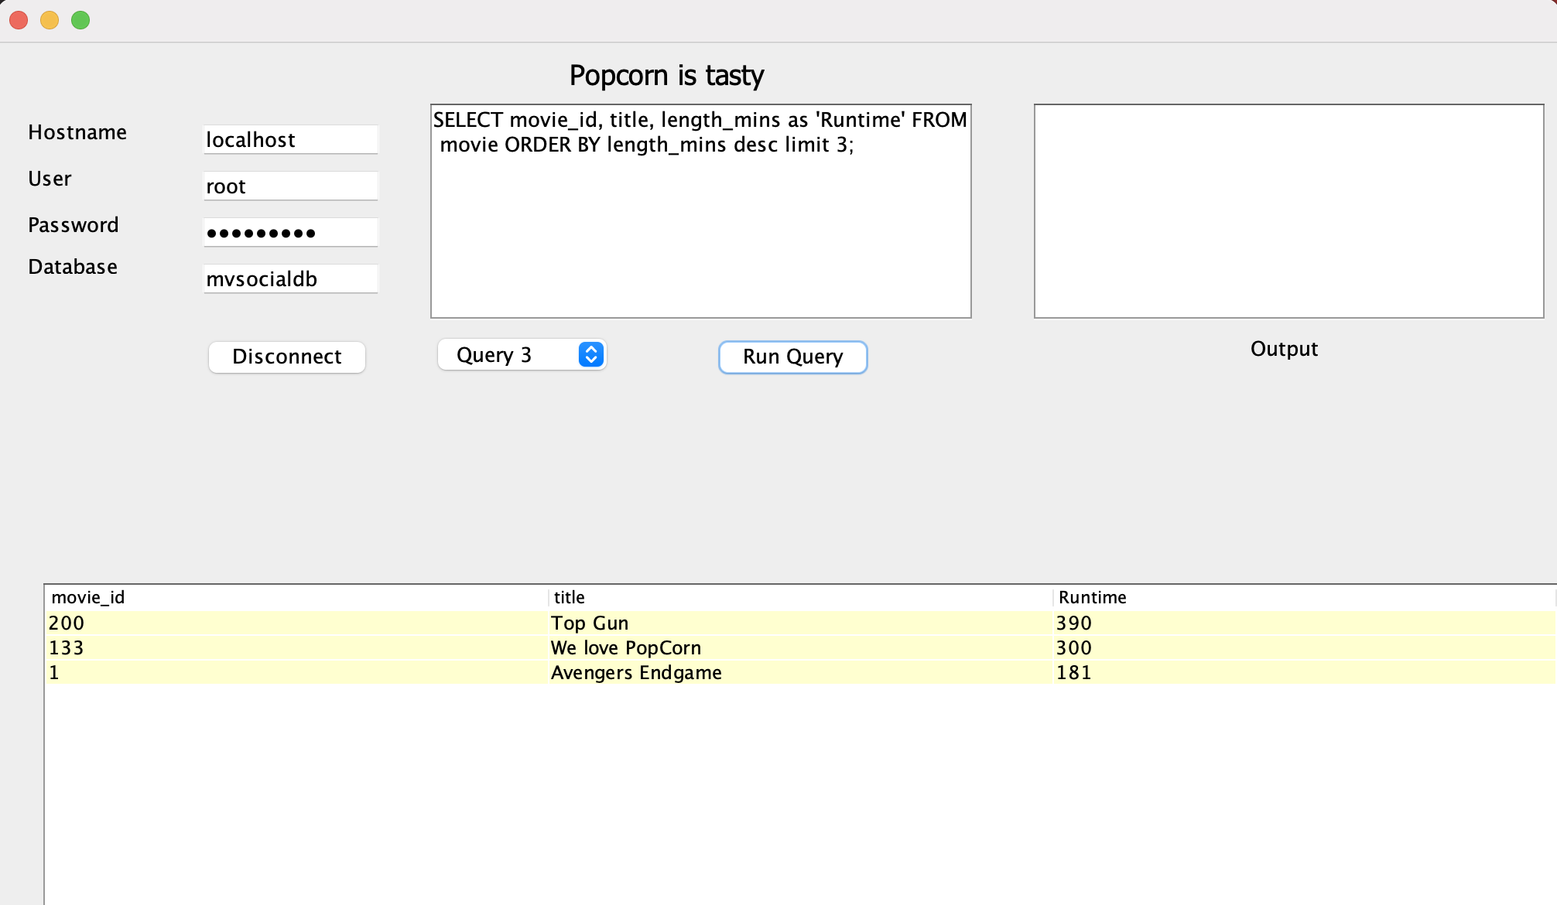
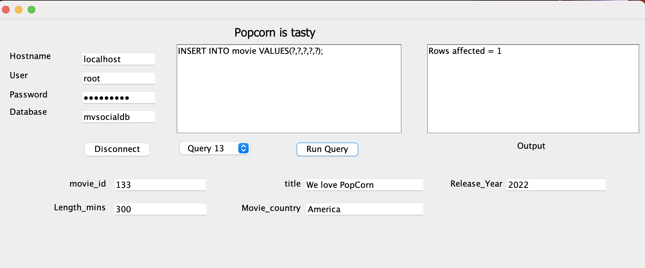
Insertion into Movies makes the result of query # 3 different. Prove that our insertion works!

Slide 27
Tableau Visualization

Slide 28
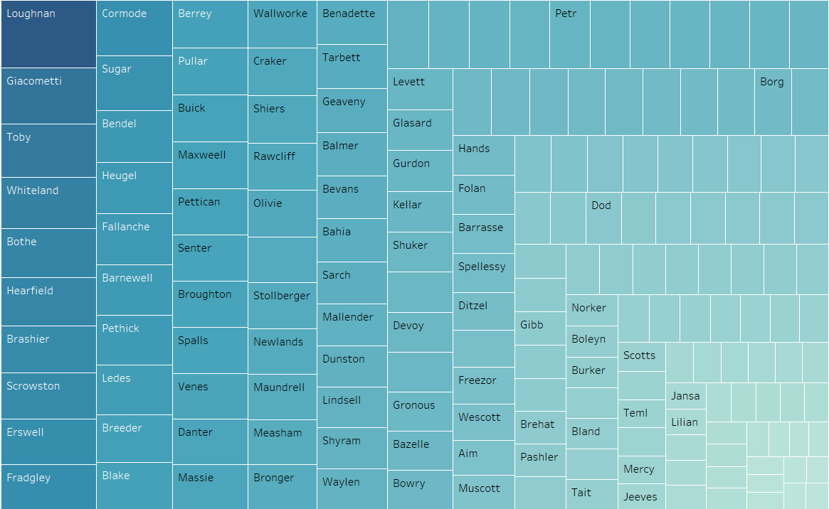
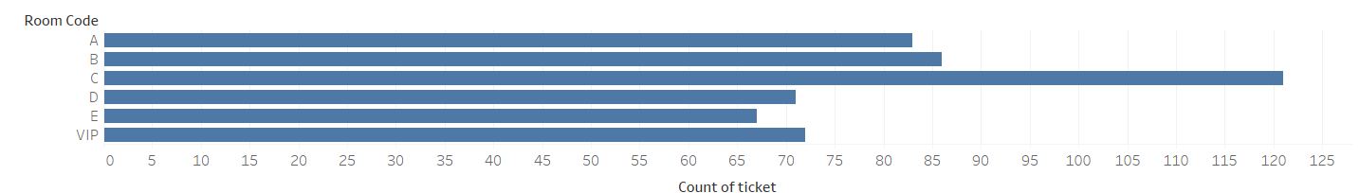
Sum of Ticket Sales Organized by User
Number of Tickets Sold Organized by Room Code

Slide 29
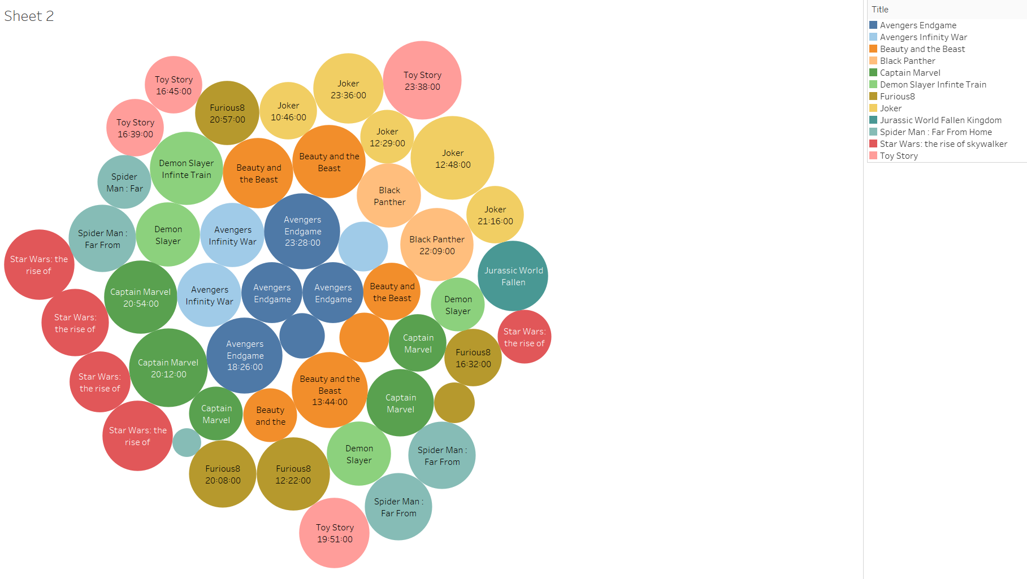
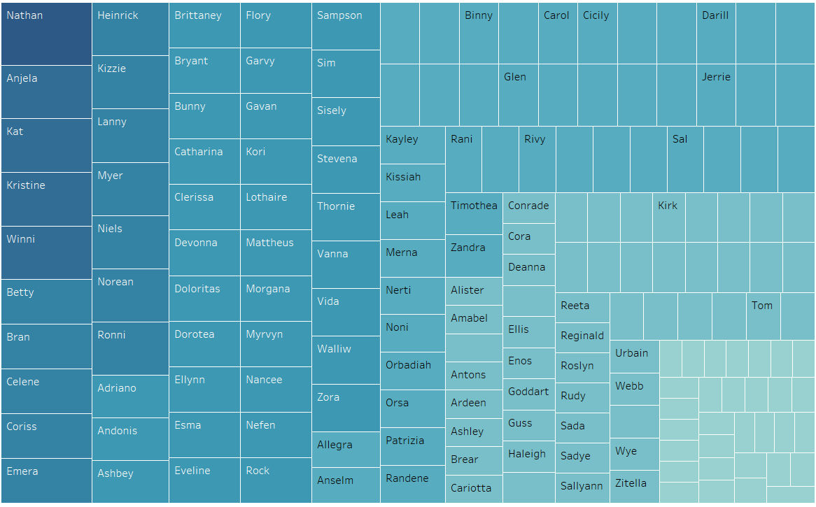
Movies Organized by Tickets Sold and Runtime
Number of Tickets Sold Organized By User

Slide 30

FUTURE IMPROVEMENTS
Auto Increment for ID values
Better/More consistent field names
Larger – Wider range of popular movies
Actual recommendations
More Social Features

Slide 31

Questions?

Slide 32

Thank you for your attention! -- team 2b

